Slide 1
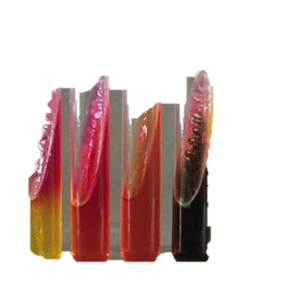
Biochemical Tests
BT233 – General Microbiology Laboratory
Next Lab: Media (Online)

Slide 2
Identification Approach: Genotypic, chemotaxonomic, and phenotypic methods of characterizing the bacteria in order to find its taxonomic position.. Colonial, cellular, and biochemical characterization is needed.

Slide 3
Biochemical tests: The tests that are performed on bacteria for their identification on the basis of their biochemical activities towards different biochemical compounds.
Each bacteria has which is called biochemical fingerprints which is a properties controlled by the cells' enzymatic system, these includes bioenergetics, biosynthesis, and biodegradation.

Slide 4
Enzymes are divided according to where it works into (Intracellular and Extracellular).
Intracellular
(Work inside the bacteria to break down the nutrients to yield energy). Ex. All enzymes
involved in fermentation, glycolysis, and Krebs cycle.
Extracellular
(Synthesized in bacteria and secreted outside the cell to convert the high molecular compounds
to low one) Ex. Amylase and Maltase

Slide 5
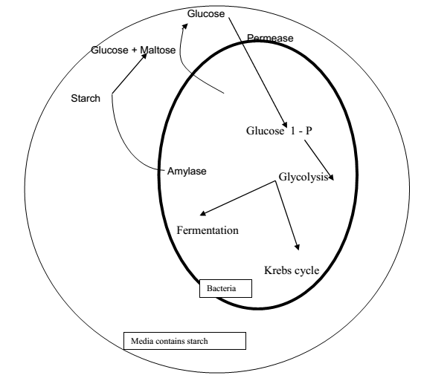

Slide 6
Intracellular Enzymes : Carbohydrate Fermentation
The differences between respiration and fermentation?
Respiration (either Aerobic or Anaerobic): in aerobic respiration use 0₂ as a final electron acceptor. In Anaerobic respiration use inorganic ions as a final electrón Aceptor e.g. NO⁻³ or SO⁻⁴
Fermentation: in biooxidations use organic substances as a final electron Acceptor and need no oxygen.

Slide 7
Test # 1: Triple Suger Iron Agar ( TSI )
Principle:To determine the ability of bacteria to ferment a specific carbohydrate incorporated into a growth medium, with or without the production of gas, along with the determination of possible hydrogen sulphide production.
This media contains:
Three different types of sugars : lactose and sucrose1.0% , and glucose 0.1%
pH indicator: Phenol red
Sulfur source: Sodium thiosulate or cysteine
Sulfur indicator: Ferrous sulfate ( FeS04 )
Carbon 'source : Peptone
Alkaline : Pink
Neutral : Red
Acidic : Yellow

Slide 8
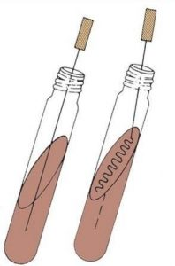

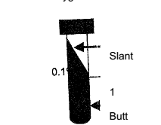
TSI Slant Agar Inoculation (Only Gram-Negative Bacteria should be used)
TSI slant agar
By sterilely cooled needle inoculate the butt of the TSI at “ 1 " from your pure culture. Then from the same culture inoculate the surface by sterile cooled loop through streaking. Incubate at 37°C for not more than 18 hours.

Slide 9
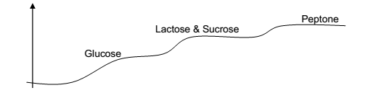
Bacteria if have enzymes to degrade both glucose, sucrose, lactose and peptone they start with the simplest then more and more complex as in the following curve:
Slant (Aerobic Reaction)
Butt (Anaerobic Reaction)
If the reaction under anaerobic at X3 the reaction under aerobic must be at X4, If the
reaction under anaerobic at X4 the reaction under aerobic must be already completed.

Slide 10
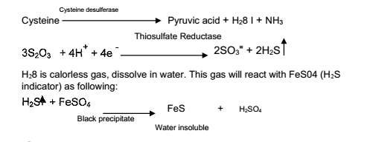
Results :
1-If there is no fermentation occurred = Red color
2-If bacteria ferment lactose and sucrose = Yellow
3-If bacteria ferment glucose = Yellow
4-If bacteria catabolize pepton = Pink
5-If bacteria produce gas from fermentation = cracks in the butt.
black precipitatein the butt. =6- If bacteria produce H₂S gas

Slide 11
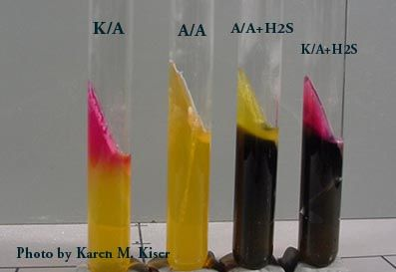
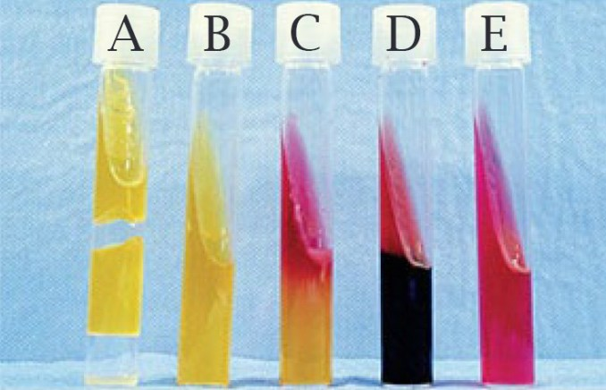
TSI Slant Results (Color of Slant / Color of Butt)
Yellow I Yellow (black color in the butt ) Acid I Acid | Yellow I Yellow (cracking in the butt ) Acid I Acid | Yellow I Yellow Acid I Acid
A/ A . H₂S | A/ A | A/ A
Lactose and I or sucrose fermenter and H₂S gas producer bacteria | Lactose and I or sucrose fermenter and gas producer bacteria | Lactose and I or sucrose fermenter bacteria

Slide 12
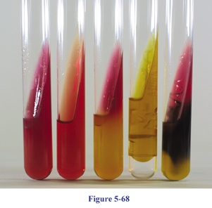
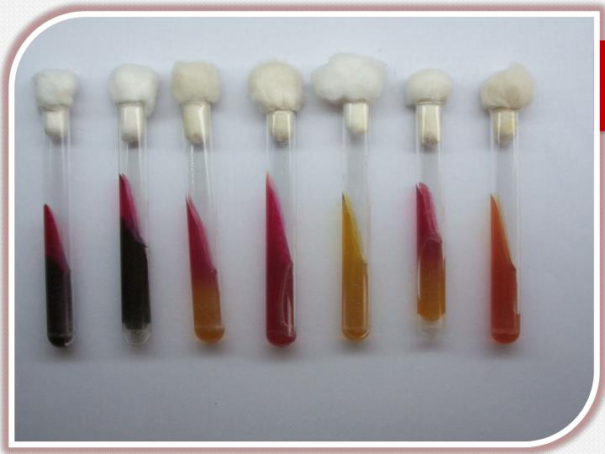
TSI Slant Results (Color of Slant / Color of Butt)
Pink /Yellow (black color in the butt ) Alkaline / Acid | Pink / Yellow (cracking in the butt ) Alkaline / Acid | Pink /Yellow Alkaline / Acid
K/ A . H₂S | K/ A | K/ A
Non -Lactose and I or sucrose fermenter and H₂S gas producer bacteria | Non -Lactose and I or sucrose fermenter and gas producer bacteria | Non -Lactose and I or sucrose fermenter bacteria

Slide 13
TSI Slant Results (Color of Slant / Color of Butt)
Pink / Pink (black color in the butt ) Alkaline / Alkaline | Pink / Pink (cracking in the butt ) Alkaline / Alkaline | Pink / Pink Alkaline / Alkaline
K/ K . H₂S | K/ K | K/ K
H₂S gas producer bacteria | Gas producer bacteria | Non carbohydrate fermenter, catabolized peptone under aerobic and anaerobic condition

Slide 14
TSI Slant Results (Color of Slant / Color of Butt)
only catabolize peptone under aerobic condition. | K/ no change | Pink / red Alkaline/no change
If the black color mask the color of butt, the color of the butt is considered yellow.
K/ no change
Why the incubation must be not longer than 18 hours?
Because for example the result is A /A and the bacteria incubate longer than 18 hours, the bacteria ferment lactose and sucrose completely, then start to degrade peptone which change the pH of the media from acid to alkaline and the result will appear K I K.
Why there is no A I K?
Because the reaction under aerobic condition is faster than that under anaerobic.

Slide 15
Test #2: IMViC Test
Indole, Methyl Red, Voges-Prosakaur, Citrate (IMViC) Tests:
The four tests comprise a series of important determinations that are collectively called the IMViC series of reactions.
The IMViC series of reactions allows for the differentiation of the various species of bacteria.

Slide 16
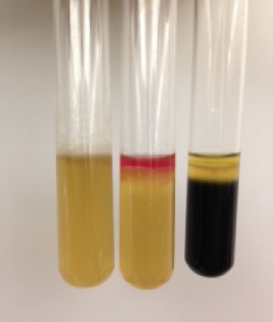
IMViC: Indole test
Principle : Certain microorganisms can metabolize tryptophan by tryptophanase The enzymatic degradation leads to the formation of pyruvic acid, indole and ammonia. The presence of indole is detected by addition of Kovac's reagent.
SIM Media : S : for sulfide, I : for Indole, and M: for Motility.
Tryptophane Tryptophanase
amino acids
Indole + Pyurvic acid + NH₃
Inoculate from your culture by just single line inoculation Using sterile cooled needle
incubate at 37°C for 48 hours
Results
SIM Media

Slide 17
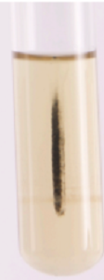
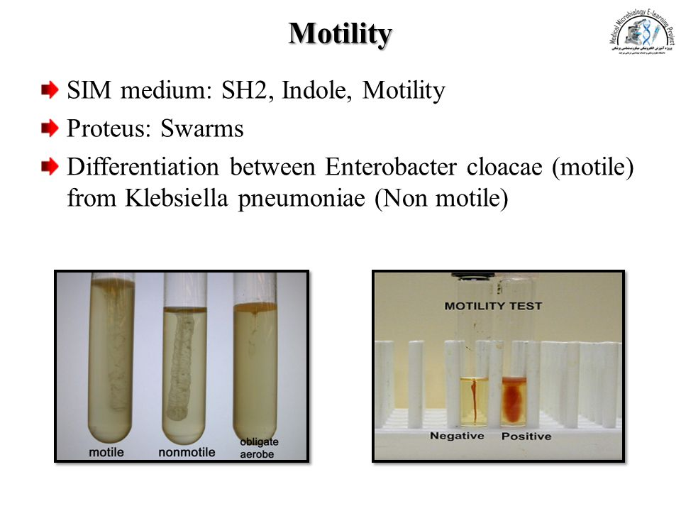
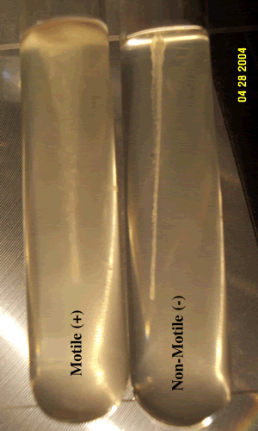
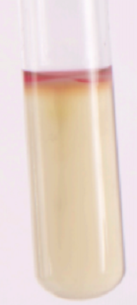
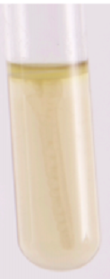
SIM Results
Sulfide test |  | Motility test |  | Indole Test
Black in the medium | No black in the medium | Bacteria grow at the inoculating line only | Bacteria grow at the surface of the media, or the bacteria grow a way from inoculating line | Add about one 1 ml of kovac's reagent to the media
 |  |  |  | If a red ring developed at the surface top within 10 minutes | If there is no red ring developed at the surface top within 10 minutes
Sulfide + | Sulfide − | Non motile | Motile | Indole + | Indole -

Slide 18
IMViC test Methyl Red-Voges Proskauer (MR-VP) Tests
Principle: Glucose
Acid
None Stable Acid
Stable End Product
Acetoin and 2,3 butanediol
Methyl Red indicator
Barrit’s reagent
40% KOH
Red color
MR positive
VP positive
Red color

Slide 19
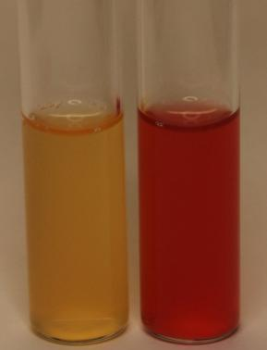

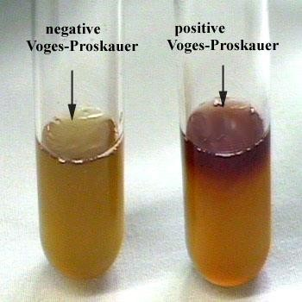
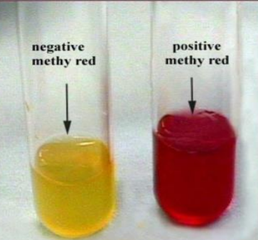
Inoculate a loopful of your pure culture using sterile cooled loop
Then divide into 2 vial
Incubate at 37°C for 48 hours.
Add 1 ml Methyl Red
indicator
Add Barritt's reagent ( alpha naphthol + 40% KOH)
MR-VP broth
Results
MR : +ve must be VP : -ve
MR: -ve could be VP : +ve or -ve
But impossible to be :MR: +ve VP: +ve
If the whole media converted to the red MR test Positive
If red ring developed VP test Positive

Slide 20




IMViC test:Citrate test
Principle: Often used for the detection of gram-negative enteric bacilli based on the ability of an organism to use citrate as the source of carbon and energy .
Citrate
Pyruvate
CO2 + Na + H₂O
Na₂CO₃ Alkaline,↑pH
inoculate the slant surface by sterile
cooled loop through streaking
incubate at 37°C for 48 hours.
Results
Citrate +
If there is growth
and/or the color of the media
converted from green to the blue
Simmone’s Citrate slant agar media
Citrate -
If there is no growth
and/or the color of the media
remains green
Simmone’s Citrate media Contains
Citrate as a carbon source
Bromothymol blue :pH indicator
Alkaline : Blue
Neutral : Green
Acidic : Yellow

Slide 21
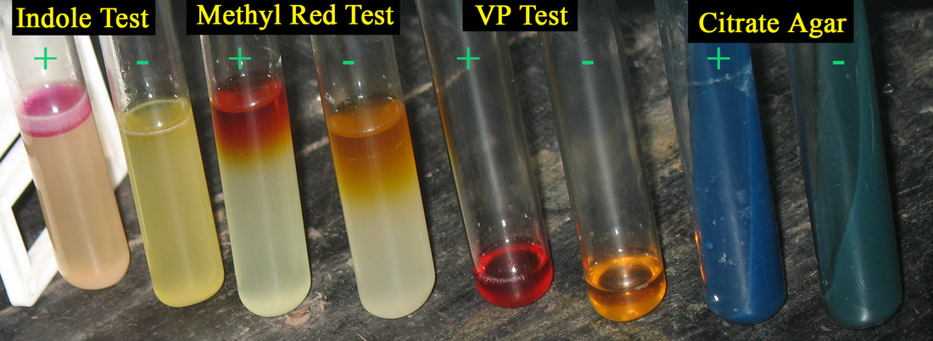

Slide 22
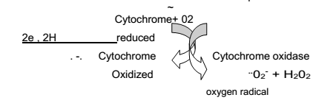

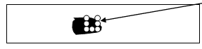
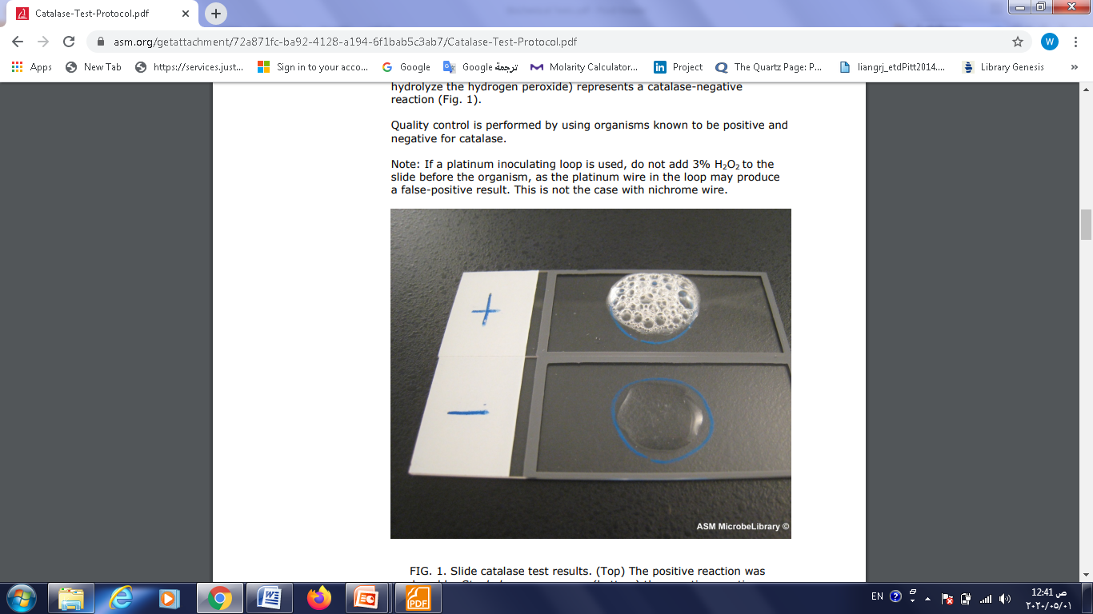
Test # 3: Catalase Test :
Principle : Test for the presence of catalase enzyme that converts hydrogen peroxide (H₂O₂ ) into water and oxygen gas. When a drop of peroxide is placed on catalase-producing bacteria, bubbles appear when the oxygen gas is formed.
In Aerobic, Facultative anaerobic, and Aerotolerant anaerobic use O₂ as final electron acceptor
Catalase +
If there are large amount of bubbles (Strong catalase positive)
If there are small amount of bubbles (Weak catalase positive)
1- Add a loopful from your pure culture into a cleaned slide.
2- Add one drops of 3% H₂O₂ ( suhstrate)
Results
Catalase -
No bubbles

Slide 23

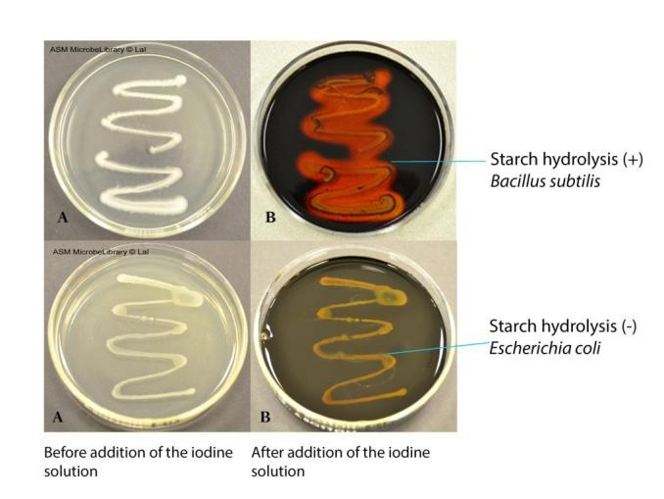
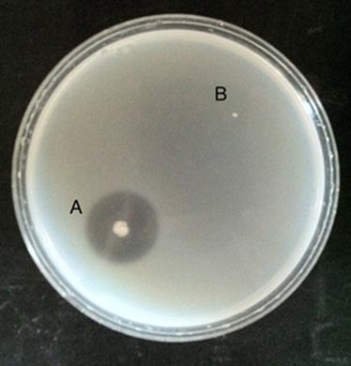
Extracellular enzymes: Gelatin test (Monomer of gelatin is amino acids)
Principle:Gelatin provides a rich source of amino acids and peptides for bacteria, but it is too large to be transported inside the cell directly . Therefore, it must first be broken down by extra-cellular gelatinase enzyme .
inoculate the media surface by sterile
cooled loop through streaking or as
a dot at the center of plate.
incubate at 37°C for 48 hours.
HgCh/ HCI will be added to the plate. HgCh/ HCI reacts with gelatin to produce white precipitate .
Results
Nutrient agar + 4 % gelatin
Gelatin +
Gelatin hydrolysis is indicated by clear zones around bacteria growth
Using HgCh/ HCI White PPt in the whole plate except area surrounding bacteria growth . (A)
Gelatin-
If gelatin has not been hydrolyzed, NO clear zones around bacteria growth
Using HgCh/ HCl White PPt in the whole plate (B)

Slide 24
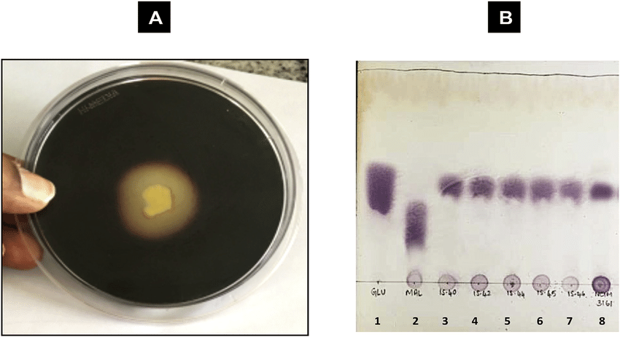
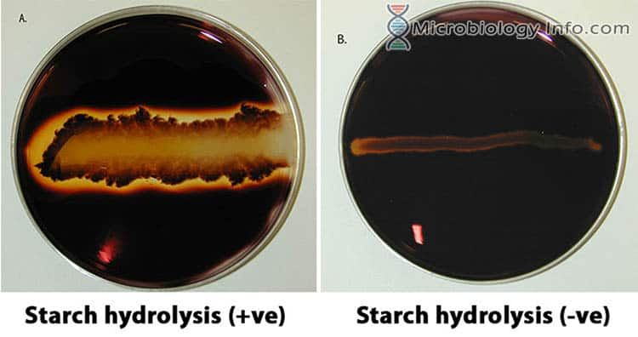
Extracellular enzymes: Starch test (Monomer of starch is glucose)
Principle : Starch is too large to pass through the plasma membrane and must be split into individual glucose molecules. So, this test aims to determine if the organism is capable of breaking down starch into its monomer through the activity of the extra-cellular α-amylase enzyme.
inoculate the media surface by sterile
cooled loop through streaking or as
a dot at the center of plate.
incubate at 37°C for 48 hours.
Iodine will be added to the plate. Iodine reacts with starch to produce a dark brown or blue/black color.
Results
Starch +
If starch has been hydrolyzed, there will be a clear zone around the bacterial growth
Using iodine dark brown or blue/black color in the whole plate except area surrounding bacteria growth .
Starch -
If starch has not been hydrolyzed,no clear zone around bacteria growth
Using iodine the agar will remain a dark brown or blue/black color
Nutrient agar +
1 % starch

Slide 25
The End

